Slide 1

Chessboard Detection and Piece Recognition
Sait Sevban Cander
Süleyman Can Ertem

Slide 2

Outline
Detecting Lines
Finding corner points
Obtain subimages of squares
Create the dataset
Train the Model
Predict the pieces
FEN notation and analysis board
Results and further work

Slide 3
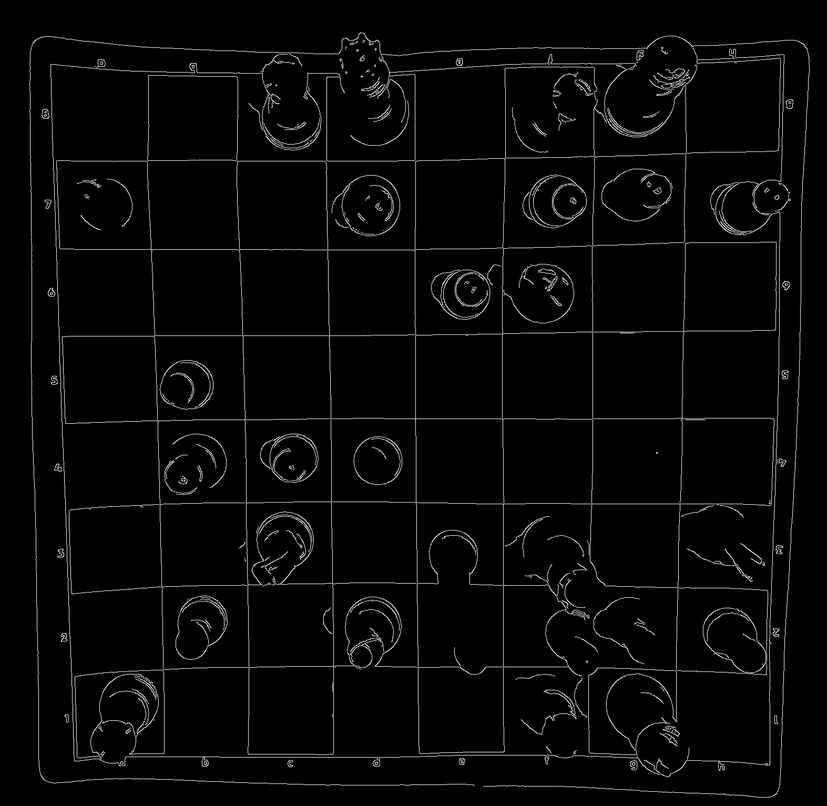
Detecting Lines
Canny Edge detector

Slide 4
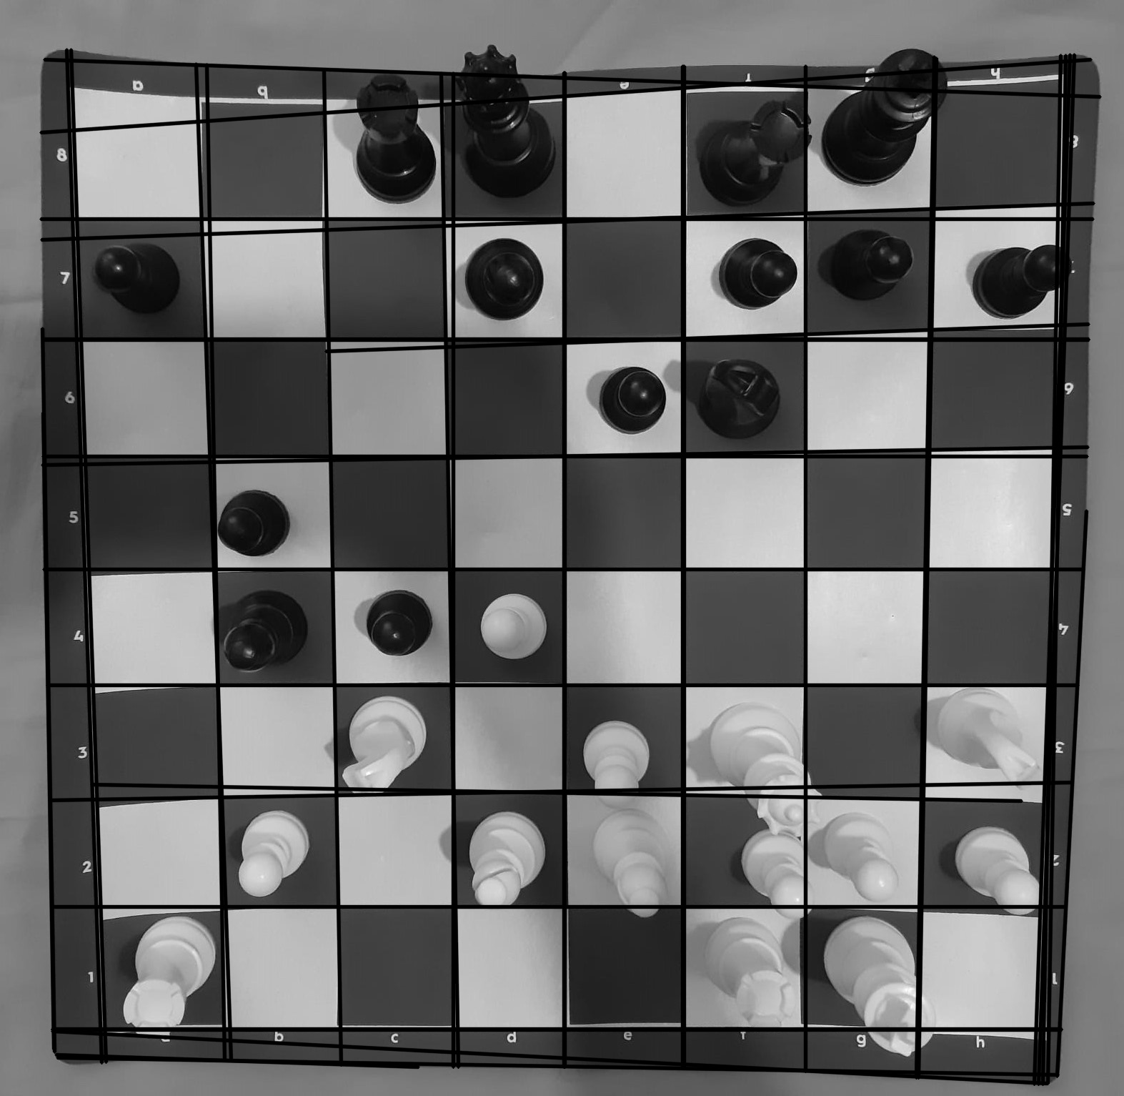
Detecting Lines
Hough Line Transform
minLineLength = 400
threshold = 215
maxLineGap = 1500

Slide 5
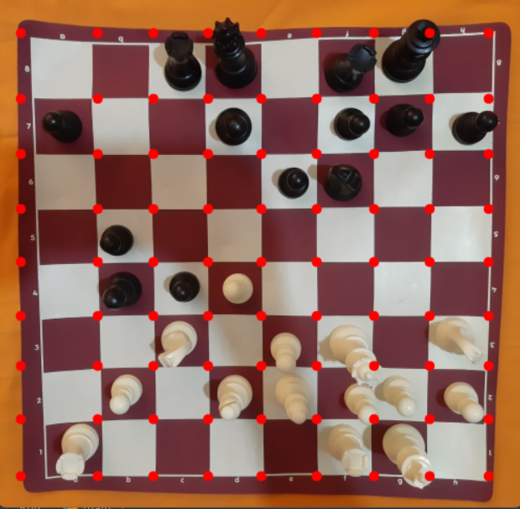
Corner Points
Horizontal and vertical
lines are seperated
Intersection points
marked

Slide 6
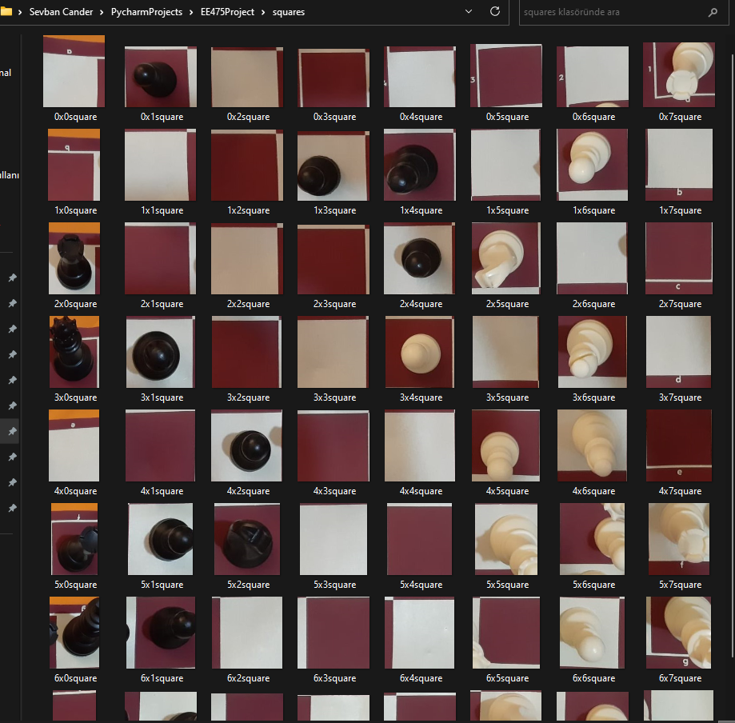
Subimages
Subimages are saved as png
format in another folder to be
categorized

Slide 7

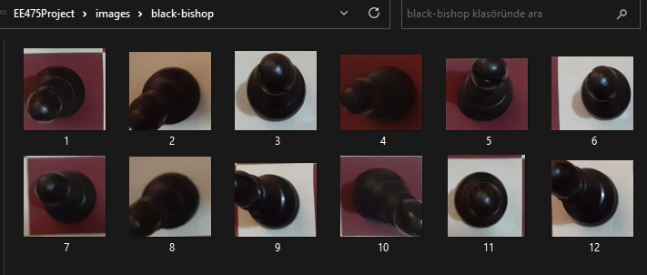
Dataset
13 categories
From 12 to 43 images
per category
Non-uniform input dimension

Slide 8
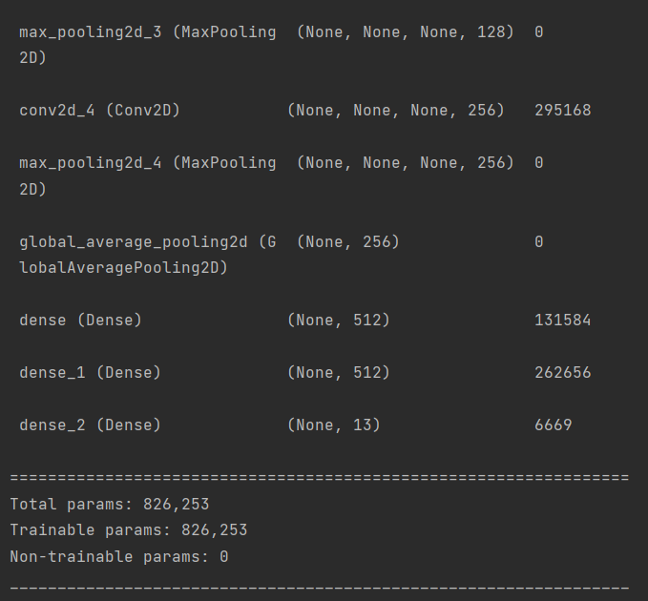
Model Summary

Slide 9
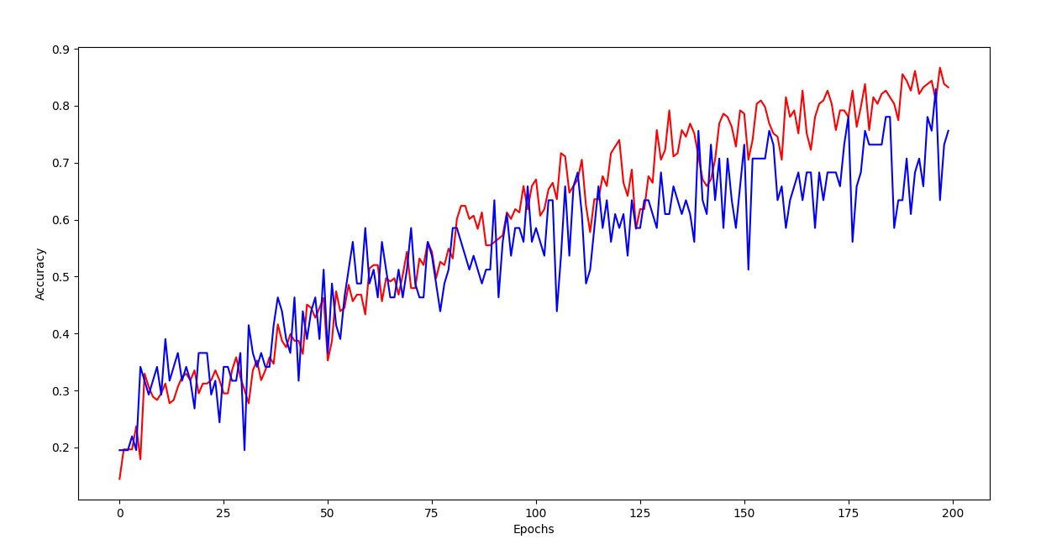
Training
Accuracy

Slide 10
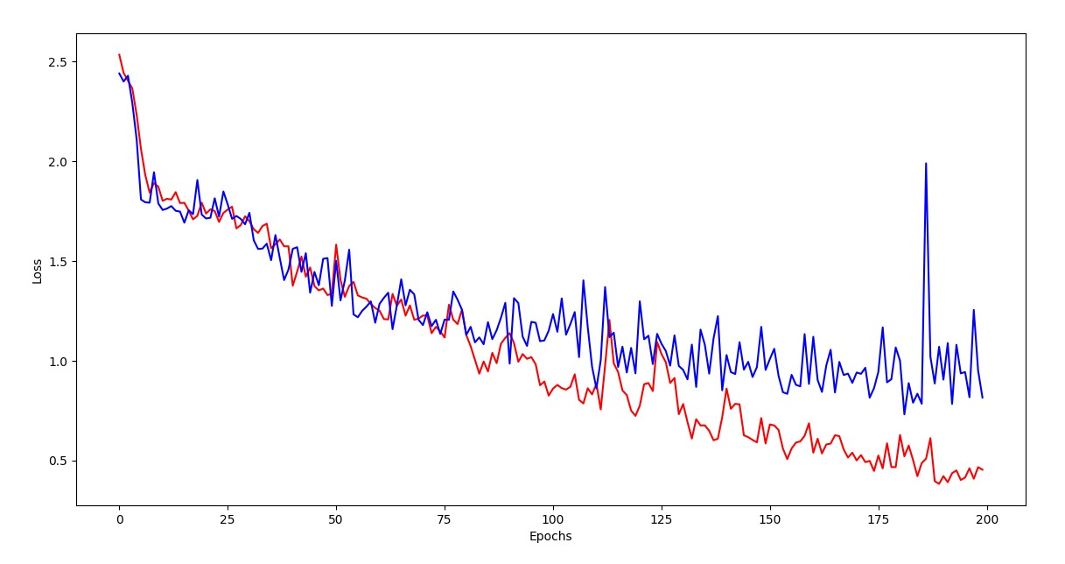
Training
Loss

Slide 11

Prediction
Model categorized each
subimage(square) individually
Labeled each square
with the most probable piece.

Slide 12
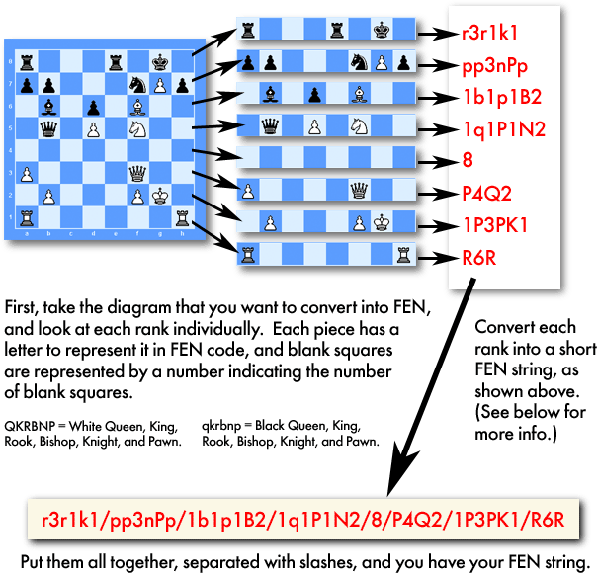
FEN Notation
Forsyth–Edwards Notation
It provides all the necessary information to restart a game from a particular position
Saved as a string

Slide 13

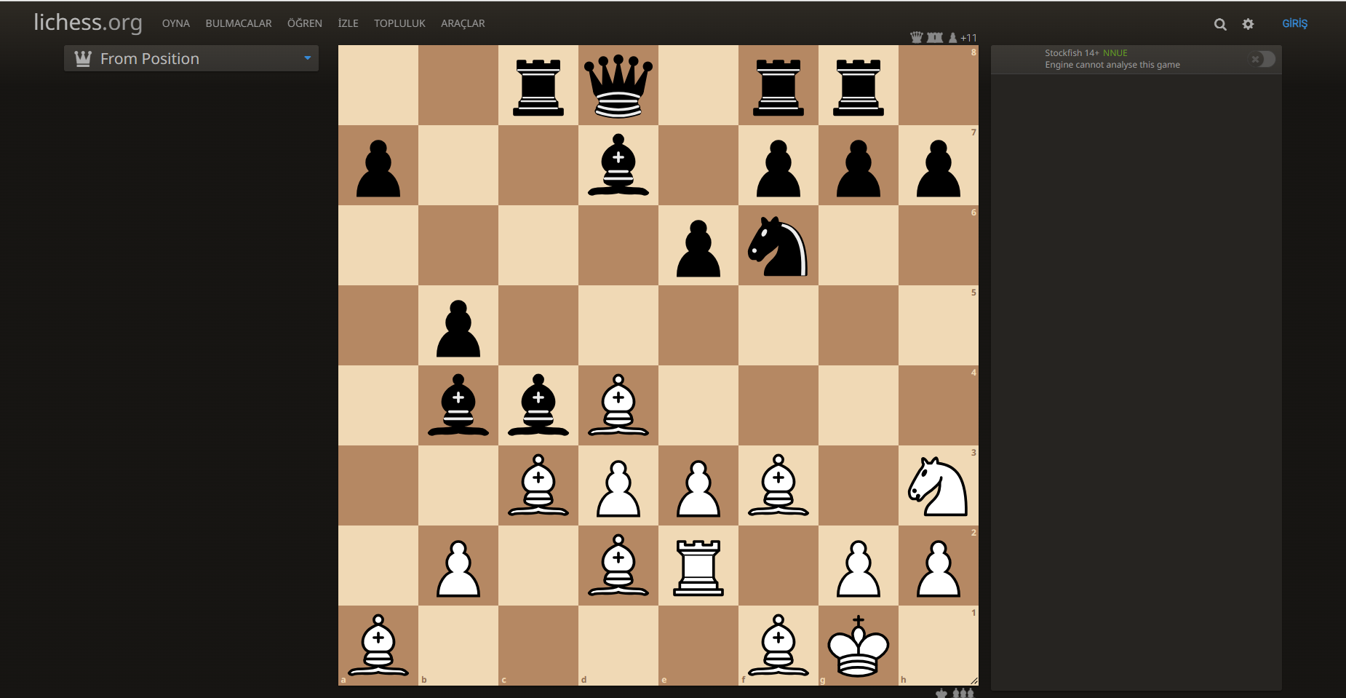
Analysis Board
Stockfish chess engine, ‘Lichess’ – automatic direction to the website

Slide 14

Results
First 100 epochs, %76 success rate
Then 200 epochs, 55/64 = %86 overall success rate
- 2 non-empty and 7 wrong categorization
Empty squares %94 successful
Too many bishops on the board

Slide 15

Possible Reasons
Quite small dataset
Non-uniform input dimension
Low quality subimages
Top view image
Similarity of chess pieces
Illumination

Slide 16

Further work
Images from every angle
Larger dataset with variety of chess sets
Live analysis from the video
Higher resolution images

Slide 17


